Slide 1
CSE115
Lecture 9
Dr. Mohammad Abu Yousuf (MAY)

Slide 2
Functions

Slide 3
What is a function?
A function is a self-contained program segment that carries out some specific, well-defined task. Every C program consists of one or more functions.
One of these functions must be called main.
Execution of the program will always begin by carrying out the instructions in main. Additional functions will be subordinate to main, and perhaps to one another.
A function will carry out its intended action whenever it is accessed (i.e., whenever the function is "called") from some other portion of the program. The same function can be accessed from several different places within a program.

Slide 4
Defining a Function
#include<stdio.h>
int twice(int x)
{
x=x+x;
return x;
}
int main() {
int x=10,y;
y=twice(x);
printf("%d,%d\n",x,y);
}

Slide 5

A function definition has two principal components: the first line (including the argument declarations), and the body of the function.
Return Type: A function may return a value. The return_type is the data type of the value the function returns. Some functions perform the desired operations without returning a value. In this case, the return_type is the keyword void.
Function Name: This is the actual name of the function. The function name and the parameter list together constitute the function signature.
Parameters: A parameter is like a placeholder. When a function is invoked, you pass a value to the parameter. This parameter is referred to as actual parameter or argument.

Slide 6
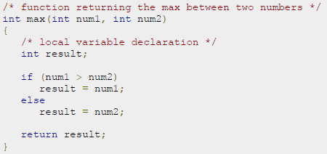
int twice(int x)
{
x=x+x;
return x;
}
Example:

Slide 7
Information is returned from the function to the calling portion of the program via the return statement.
In general terms, the return statement is written as
return expression;
The value of the expression is returned to the calling portion of the program. The expression is optional. If the expression is omitted, the r e t u r n statement simply causes control to revert back to the calling portion of the program, without any transfer of information.

Slide 8
Local Variables
Local Variables
int func1 (int y) { int a, b = 10; float rate; double cost = 12.55; ....... }
Those variables declared “within” the function are considered “local variables”.
They can only be used inside the function they were declared in, and not elsewhere.

Slide 9
Calling a Function
While creating a C function, we give a definition of what the function has to do. To use a function, we will have to call that function to perform the defined task.
When a program calls a function, program control is transferred to the called function. A called function performs defined task, and when its return statement is executed or when its function-ending closing brace is reached, it returns program control back to the main program.
A function can be accessed (i.e., called) by specifying its name, followed by a list of arguments enclosed in parentheses and separated by commas.

Slide 10
Calling a Function (Cont…)
The arguments appearing in the function call are referred to as actual arguments, in contrast to the formal arguments that appear in the first line of the function definition. (They are also known simply as arguments, or as actual parameters.)
#include<stdio.h>
int twice(int x) {
x=x+x;
return x;
}
int main() {
int x=10,y;
y=twice(x); // calling the function
printf("%d,%d\n",x,y);
}

Slide 11
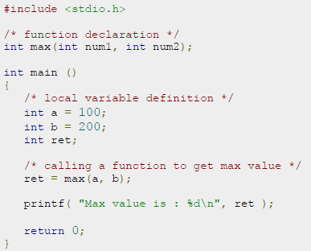
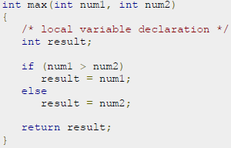

Slide 12
Function prototype
Many programmers prefer a "top-down" approach, in which main appears ahead of the programmer-defined function definition.
In such situations the function access (within main) will precede the function definition. This can be confusing to the compiler, unless the compiler is first alerted to the fact that the function being accessed will be defined later in the program. A function prototype is used for this purpose.
Function prototypes are usually written at the beginning of a program, ahead of any programmer-defined functions (including main).
return_type function_name (parameter list )

Slide 13
Example: Function Prototype
#include<stdio.h>
int twice(int x) ; // Prototype
int main() {
int x=10,y;
y=twice(x);
printf("%d,%d\n",x,y);
}
int twice(int x) {
x=x+x;
return x;
}
#include<stdio.h>
int twice(int x) {
x=x+x;
return x;
}
int main() {
int x=10,y;
y=twice(x);
printf("%d,%d\n",x,y);
}

Slide 14
Passing Argument to a Function
When a single value is passed to a function via an actual argument, the value of the actual argument is copied into the function. Therefore, the value of the corresponding formal argument can be altered within the function, but the value of the actual argument within the calling routine will not change. This procedure for passing the value of an argument to a function is known as passing by value.

Slide 15
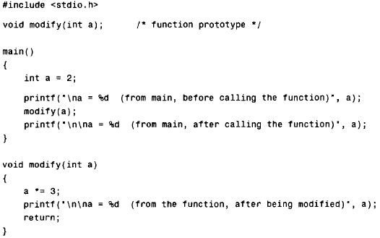
Example: Passing by value

Slide 16
Example: Passing by value (Cont..)
The original value of a (i.e., a = 2) is displayed when main begins execution. This value is then passed to the function modify, where it is multiplied by 3 and the new value displayed. Note that it is the altered value of the formal argument that is displayed within the function. Finally, the value of a within main (i.e., the actual argument) is again displayed, after control is transferred back to main from modify.
When the program is executed, the following output is generated.
a = 2 (from main, before calling the function)
a = 6 (from the function, after being modified)
a = 2 (from main, after calling the function)

